Slide 1

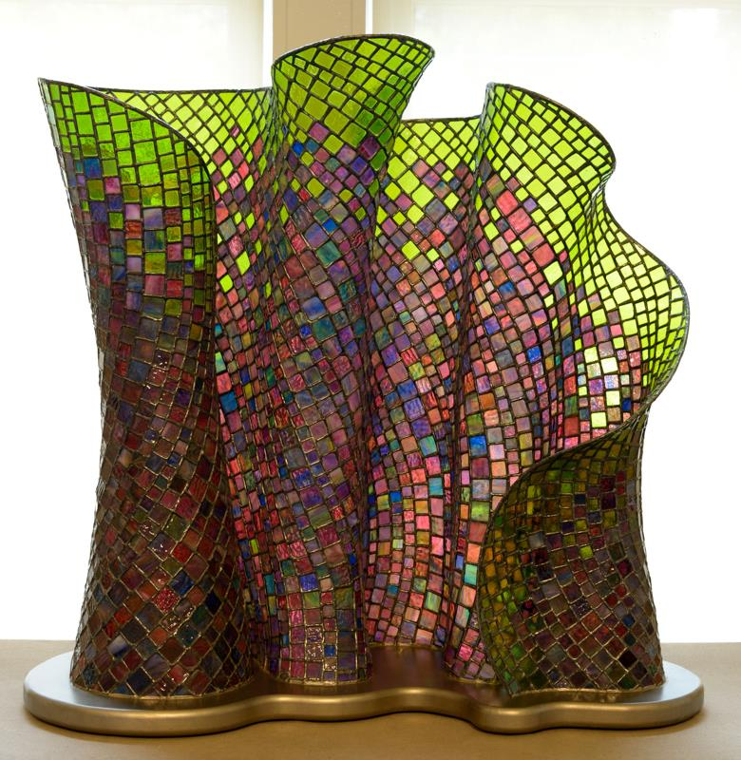
By Dan Neil Barnes,
Glass Artist
Lexington, Kentucky

Slide 2
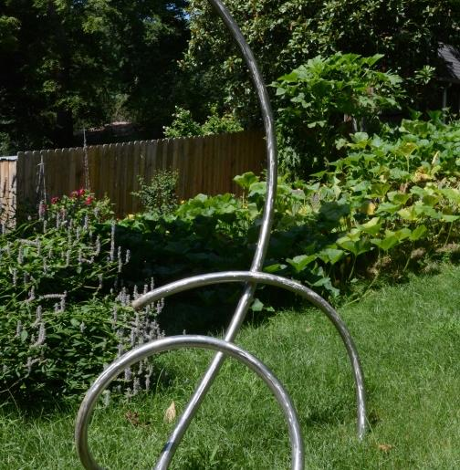
Morphed by Dave Caudill,
Metal Sculptor
Louisville, Kentucky
Stainless Steel. 7’ tall

Slide 3
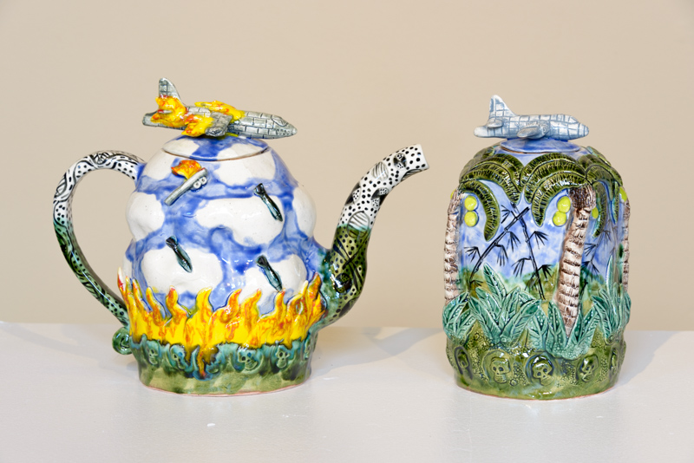
Jar and Teapot from Vietnam Series by Wayne Ferguson, Potter
Louisville, Kentucky
Each 8” high

Slide 4
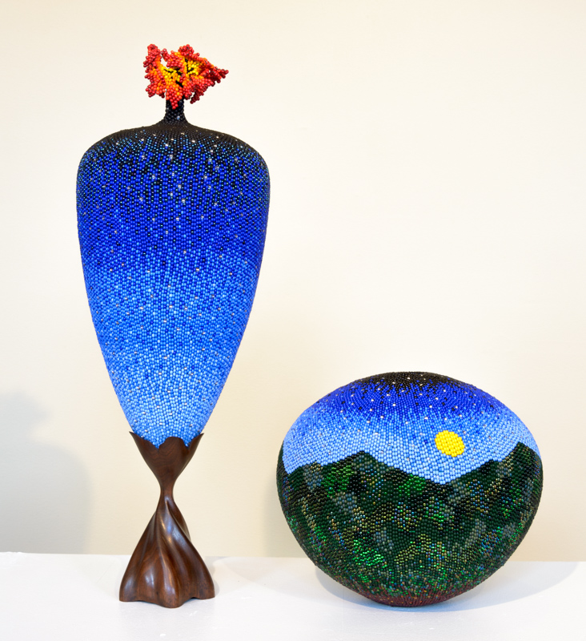
Hills of Home by Linda Fifield, Bead Artist
McKee, Kentucky
Beadwork over hollow, turned wooden vessel

Slide 5
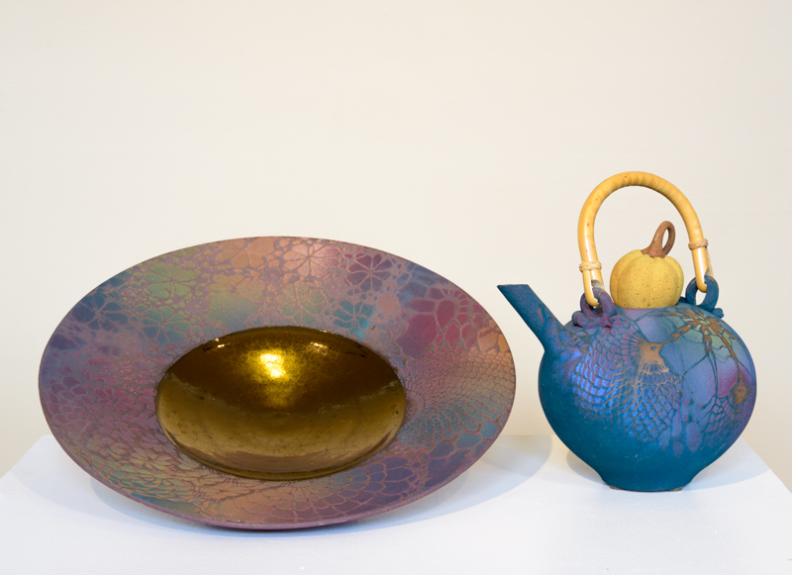
16” Ceramic Plate and Teapot by Sarah Frederick,
Potter
Louisville, Kentucky

Slide 6
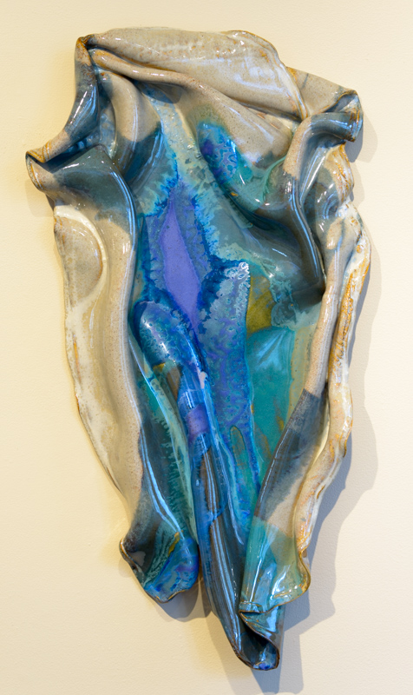
Ceramic Wall Hanging by Susan Goldstein, Potter
Lexington, Kentucky

Slide 7
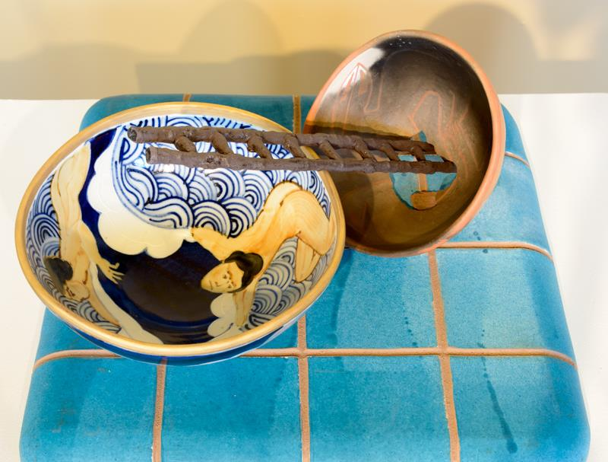
The Swimmer Learns to Drown by Walter Hyleck, Potter
Berea, Kentucky
Clay Vignette

Slide 8
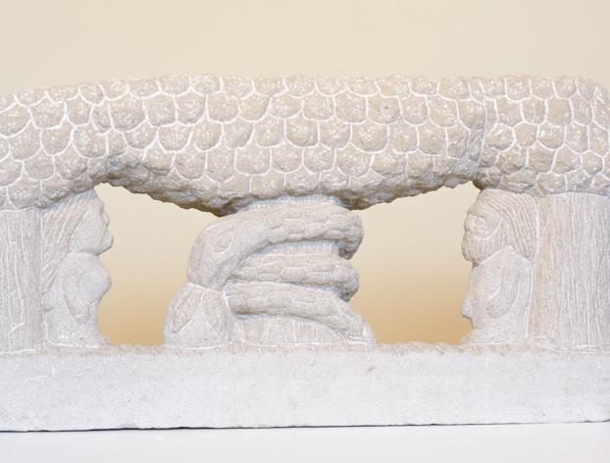
Adam and Eve by Tim Lewis, Carver
Isonville, Kentucky
Carved stone
15” x 29”

Slide 9
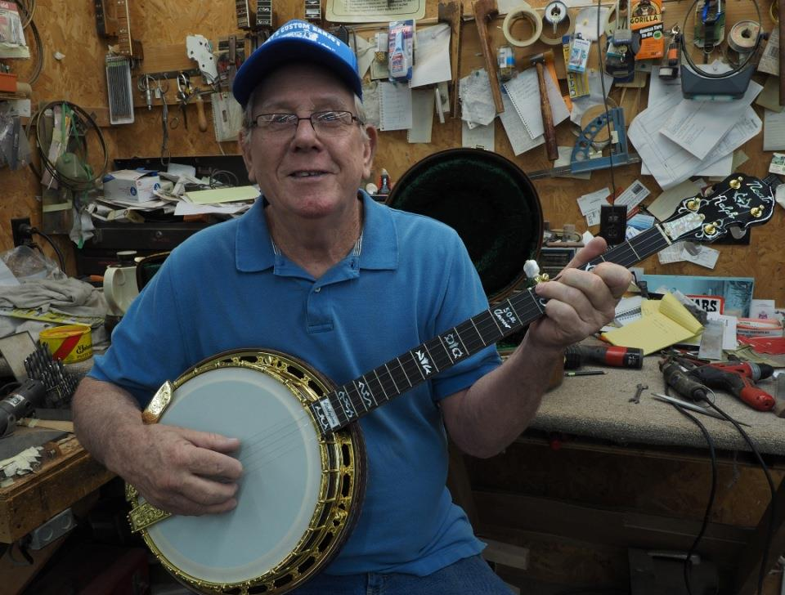
Frank Neat, Luthier
Russell Springs, Kentucky
“The different players, they get different tones from a banjo so you have to figure out what tone they are getting before you can really know what they want, before you know what it takes to get the sound they are wanting.”
BIO

Slide 10
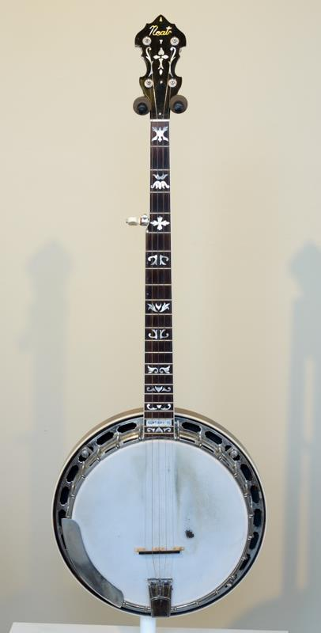
Banjo

Slide 11
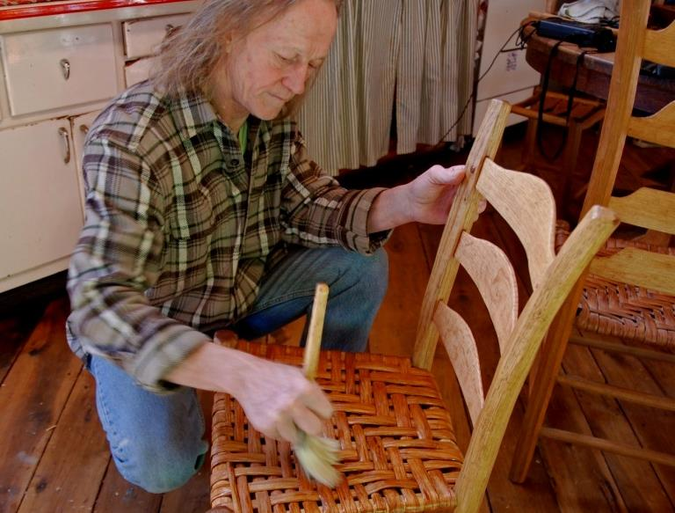
Terry Ratliff, Woodworker
Martin, Kentucky
“I have been heavily influenced by the work of the renowned chairmaker Chester Cornett, who used to say, ‘It takes half a fool to make a handmade basket and a pure fool to make a hand carved chair.’ “
BIO

Slide 12
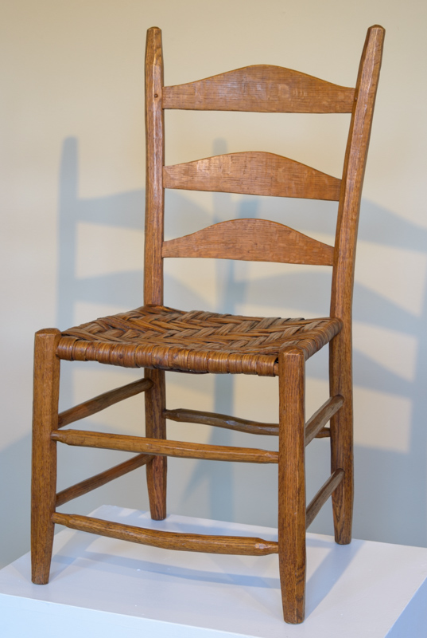
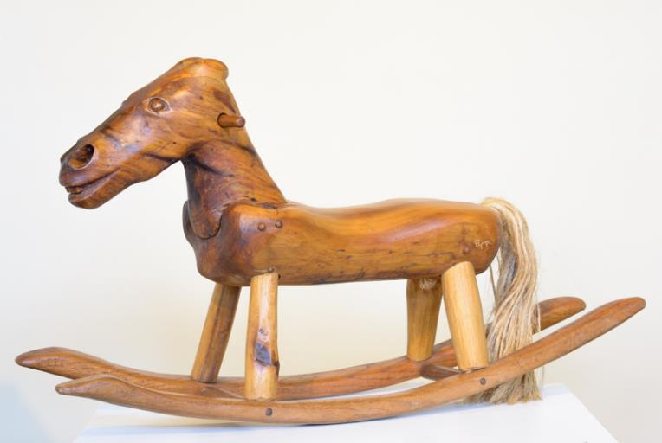
Rocking Horse and
Chair

Slide 13
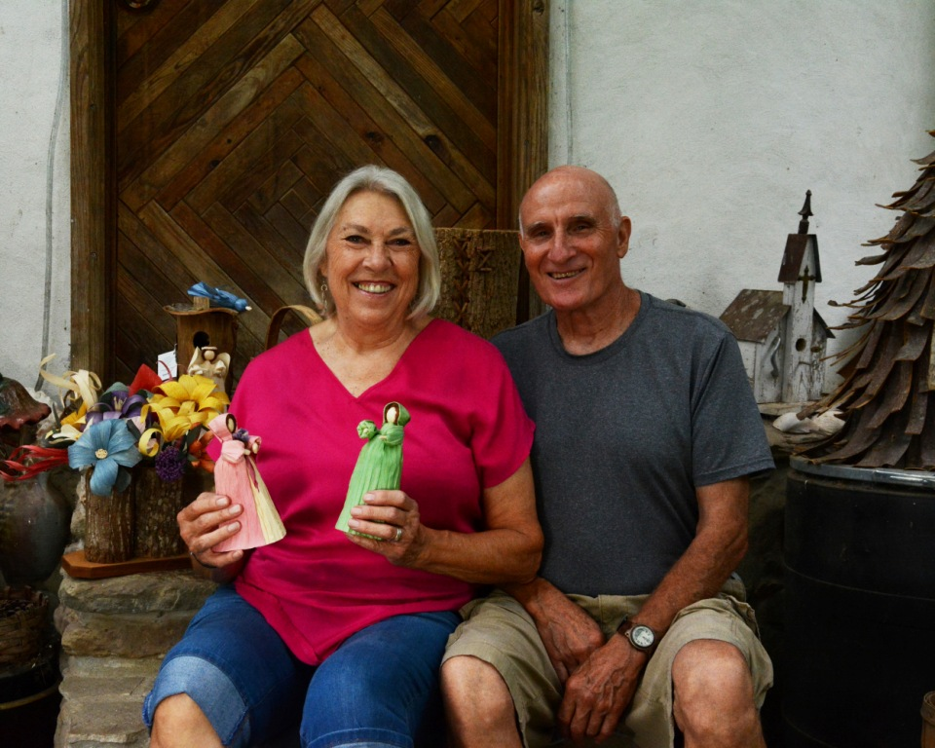
Mary & Robin Reed, Mixed Media Irvine, Kentucky
“We have worked with natural materials that are available to us in our surroundings, in our environment here in the woods, . . . our inspiration comes from the beauty of the nature around us.”
BIO

Slide 14
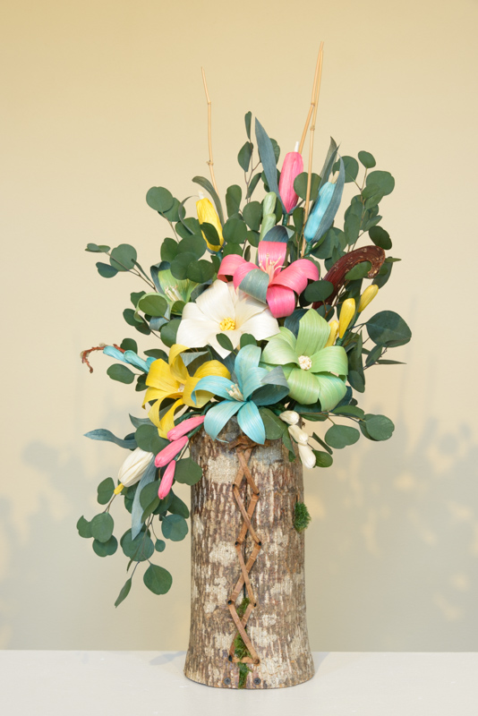
Bark Basket and
Corn Shuck Flowers

Slide 15
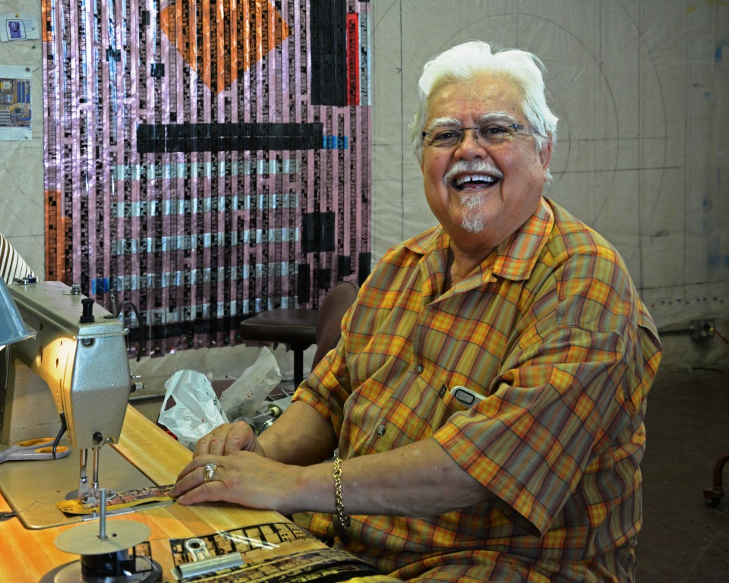
Arturo Alonzo Sandoval, Weaver Lexington, Kentucky
“And so, I don’t give up process or tradition, I incorporate it. And when in incorporating it, it becomes my own type of visual language . . . that hasn’t before been created, and so I sometimes fit between craft shows, art shows.”
BIO

Slide 16
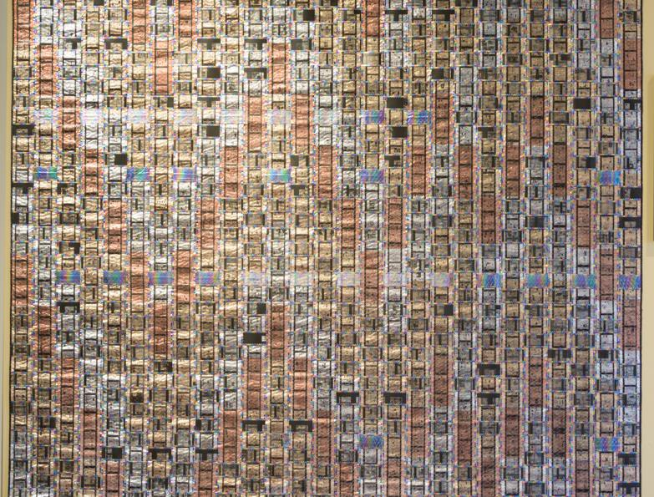
Pattern Fusion No. 1, 2004
60.5” x 60.5”, machine stitched and interlaced; recycled auto industry Mylar, recycled library 35 mm microfilm, netting, monofilament and multi-colored threads, plaited braid, Pellon, polymer medium, fabric backed.

Slide 17
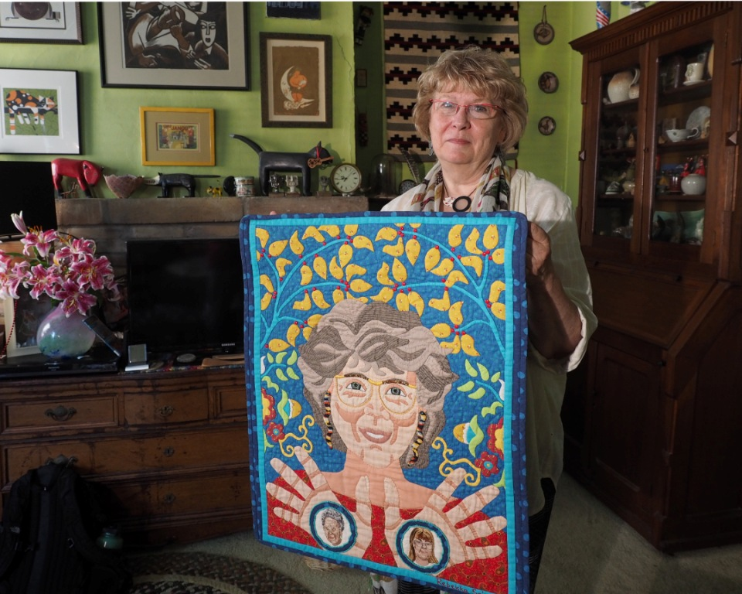
Rebekka Seigel, Quilter
Owenton, Kentucky
“I make art because I have to. That’s why anyone makes art, because you have to. My quilts were never made traditionally for beds. They were artistic expressions. Artists have a freedom to express themselves and the drive to do it.”
BIO

Slide 18
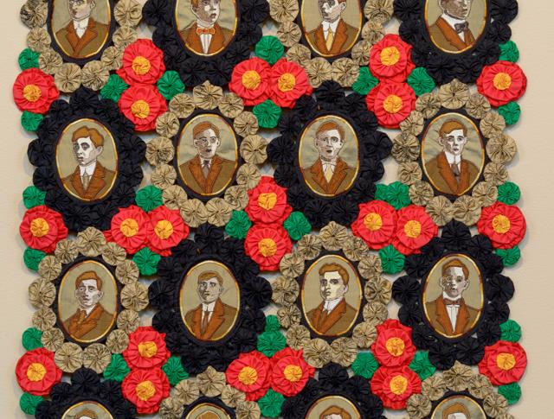
The Real Cost of War: THE CLASS OF 1911
22” X 29”
2006
My husband’s grandfather’s yearbook provided the faces for this piece. The sepia tones reﬂect the color of photographs in that era and the red poppies tying the whole piece together
refer to Flanders Fields, where so many of them died during W.W.I. The poppy became a symbol for the VFW as a result of that brutal moment in world history.

Slide 19
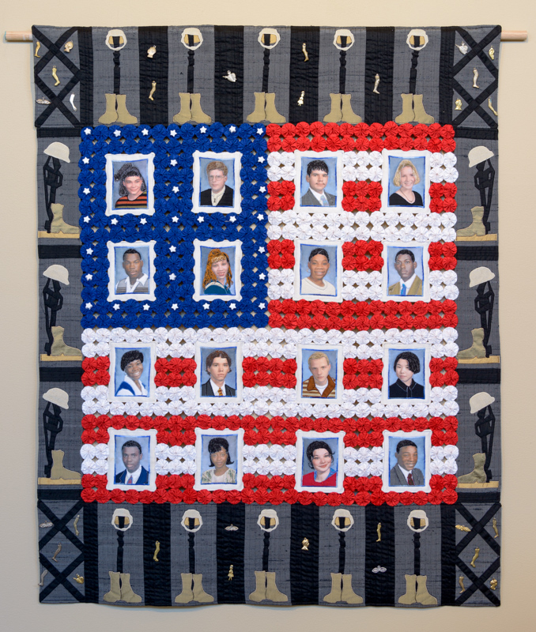
The Real Cost of War: THE CLASS OF 2002
33” X 41 1/2 “
2006
The ﬁnal piece in this series is based on the image of the American ﬂag. The portraits in this piece were scanned into a computer directly from my son’s yearbook and printed onto silk. The photos are surrounded by the disturbing image of the boots, gun and helmet of fallen soldiers used in battleﬁeld memorials. The cost of war for other soldiers is memorialized with the addition of milagros of arms, legs, eyes and mental capacity sacriﬁced in the line of duty.

Slide 20
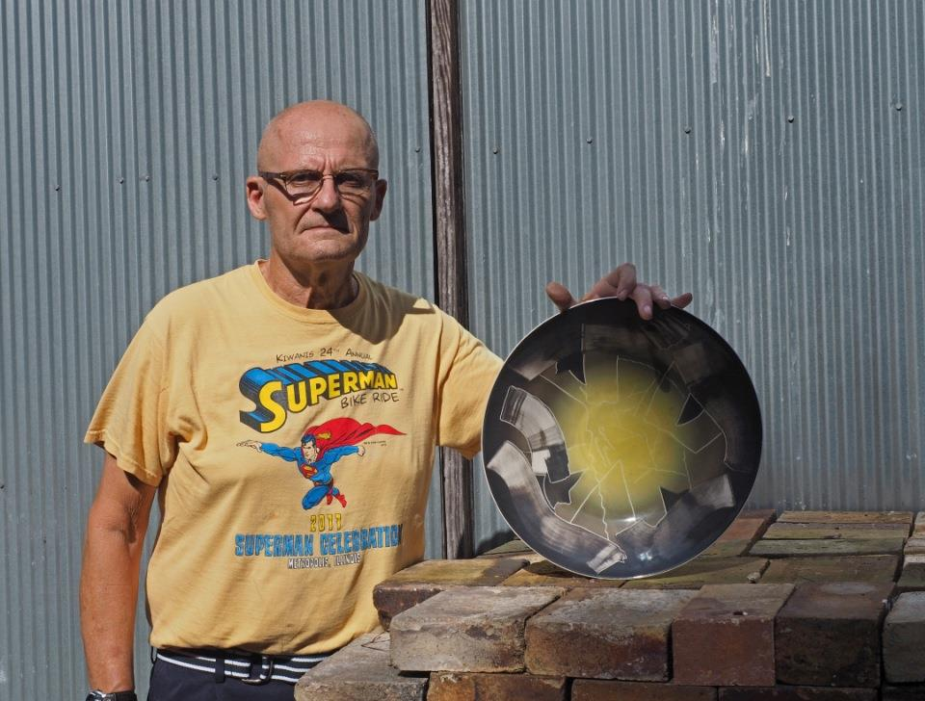
Fred Shepard, Potter
Murray, Kentucky
“And that’s the way the work goes, because each piece spawns another piece, spawns another piece . . . spawns another piece. There’s an interplay between the designing and the building of everything.”
BIO

Slide 21
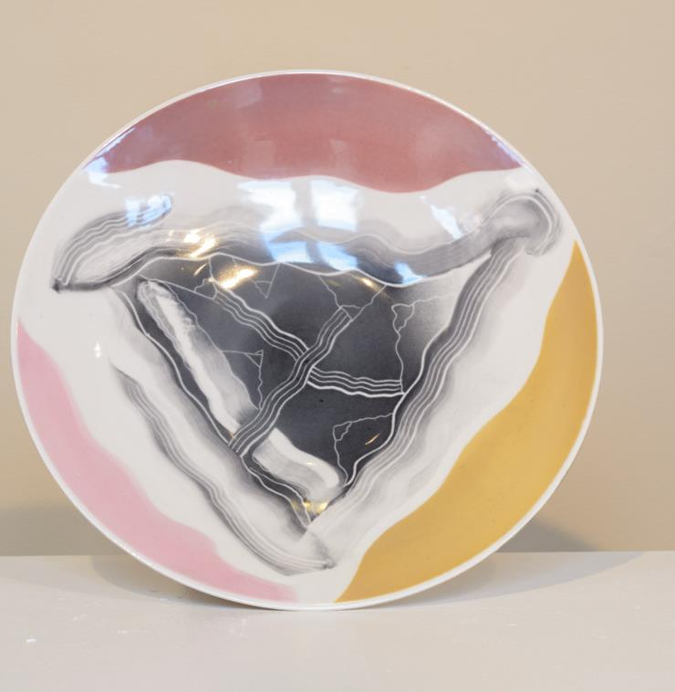
Clay Platter

Slide 22
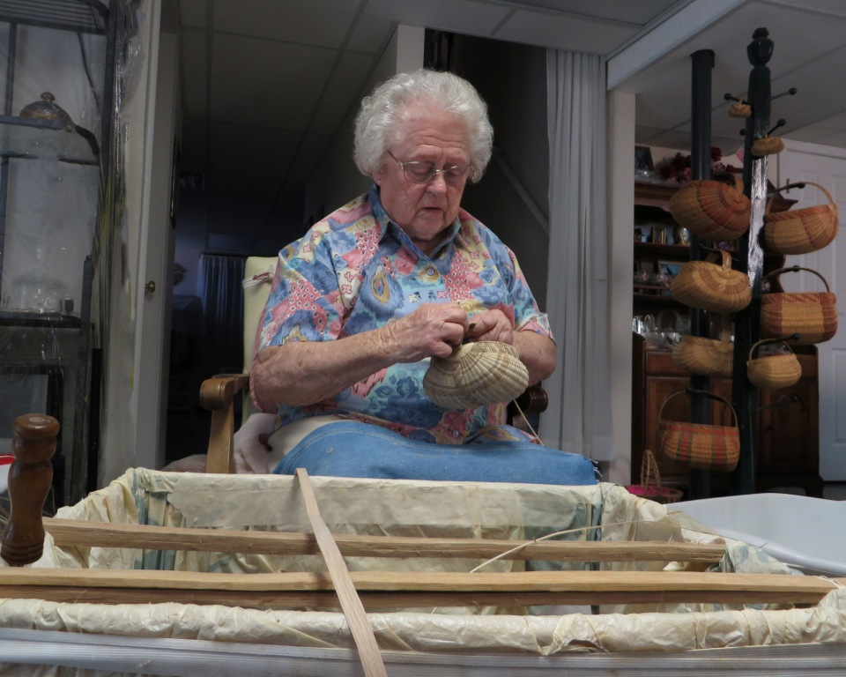
Leona Waddell, Basketmaker Cecilia, Kentucky
“I’ve been making baskets on and off since I was about nine years old, helping my mom to start out.”
﻿BIO

Slide 23
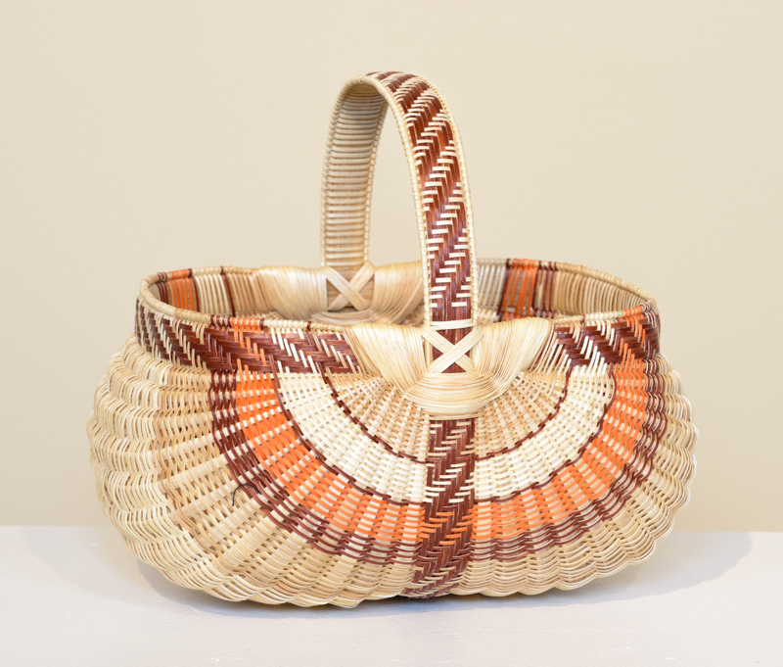
White Oak Egg Basket

Slide 24
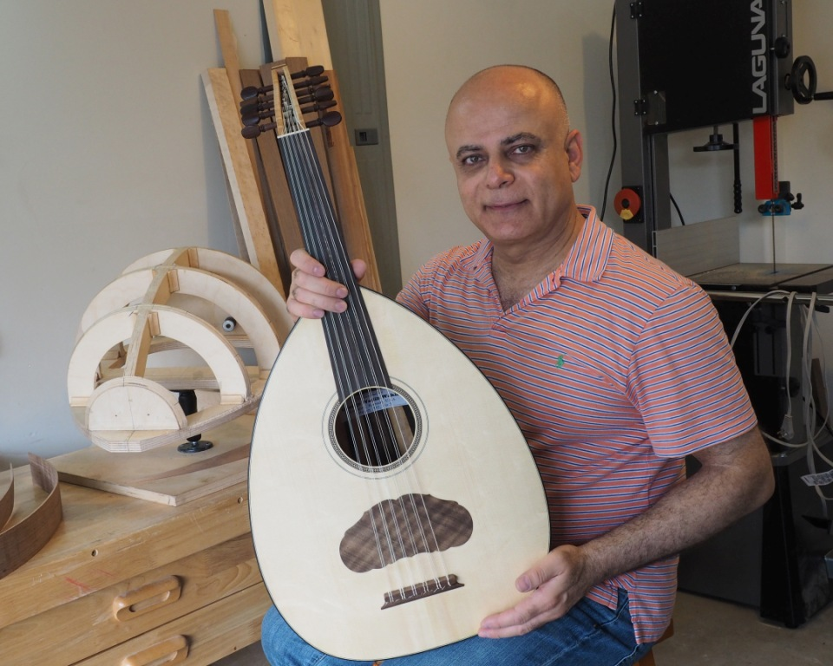
George Wakim, Luthier
Lexington, Kentucky
“I’m in the business of making an instrument that will actually serve the musician and will emanate and give the best sound that it can.”
﻿BIO

Slide 25
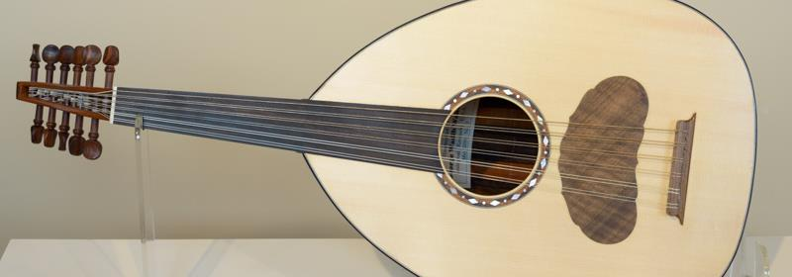
Wooden Oud

Slide 26
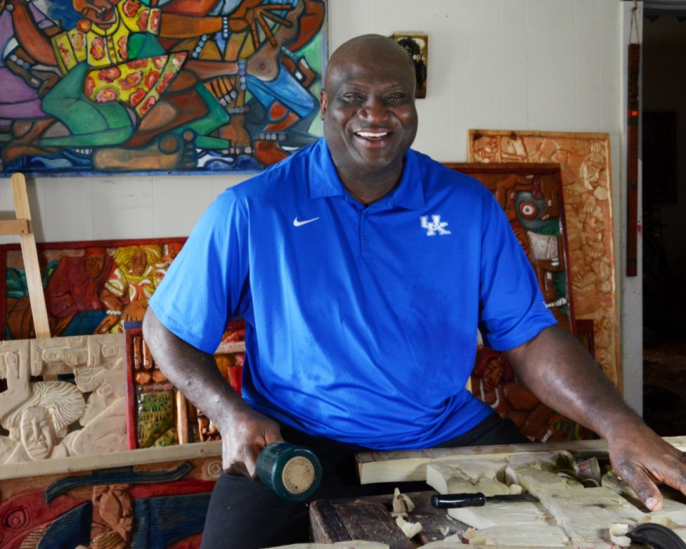
Lavon Williams, Carver
Lexington, Kentucky
“. . . the history lesson here of, of African-Americans in the South . . . you’ve got the music, you have the coming and going of the people, you have the wisdom of the people, you have these feet which means people are planted, are rooted in this place and can’t be moved.”
﻿BIO

Slide 27
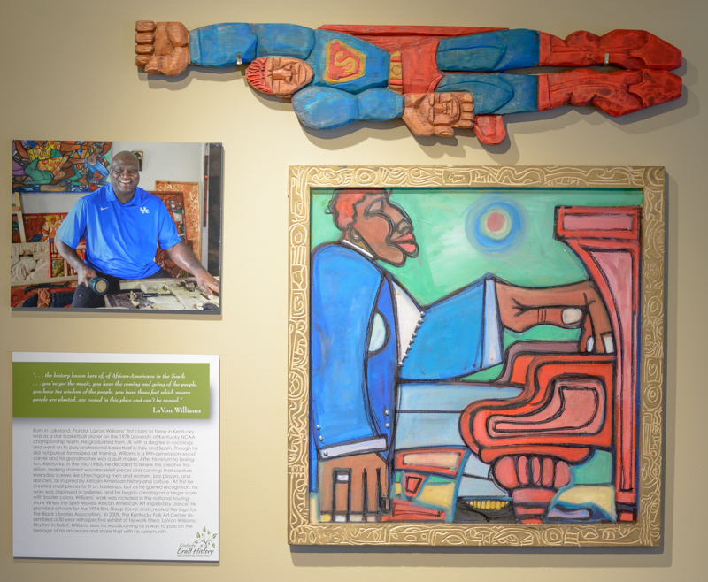

Slide 28
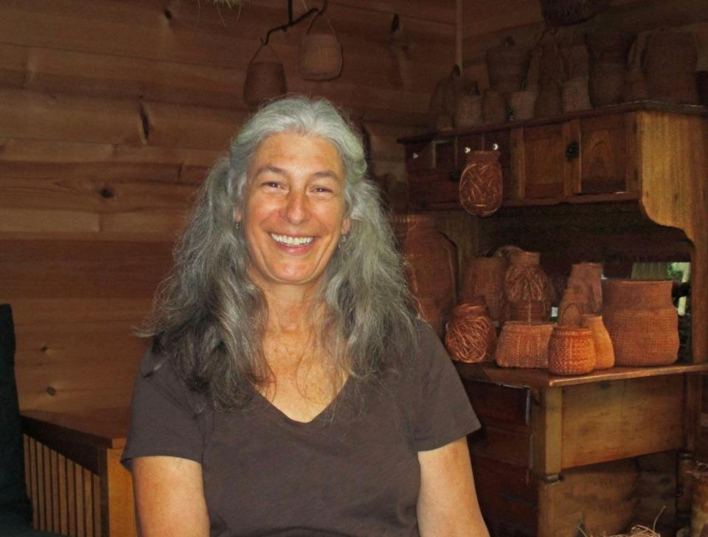
Jennifer Zurick, Basketmaker Berea, Kentucky
"I aspire to create simple, elegant woven vessels that possess a richness of spirit and a presence embodying the soul of the tree from which they came.”
BIO

Slide 29
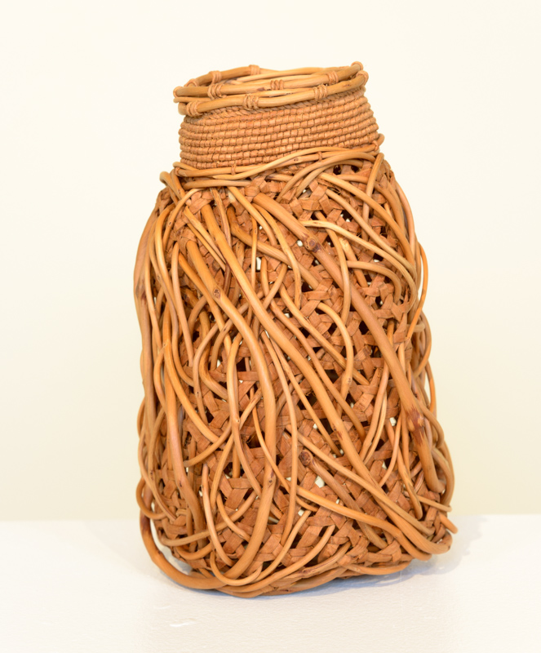
Entwined # 1
Willow bark basket, 10” high , 6” diameter

