Slide 1
Virtual Exhibit Guide Sponsored by the Kentucky Craft History & Education Association

Slide 2
What do curators do?
Museums and other institutions have curators. Curators select artworks, artifacts, and other objects for preservation and presentation.
There are also temporary curators who work on special exhibits in a museum, gallery, or other venue.
Curators decide how to exhibit artwork so that people can see it easily and it is protected. They decide how to interpret it so that the exhibit communicates meaning.
Sometimes one curator does all the jobs. Sometimes there are several curators doing different jobs.
Curators must make decisions about each exhibit.
What are some of those decisions?

Slide 3
Deciding on an Exhibit: Theme
What will all the artworks in your exhibit have in common?
What story do you want your exhibit to tell?
What do you want your audience to discover?
What do you want them to think about?

Slide 4
Selecting Artists and Artworks
What is the criteria for selection of the artists or artworks?
Are you going to contact artists and invite them to participate or are you going to have a jurying process?

Slide 5
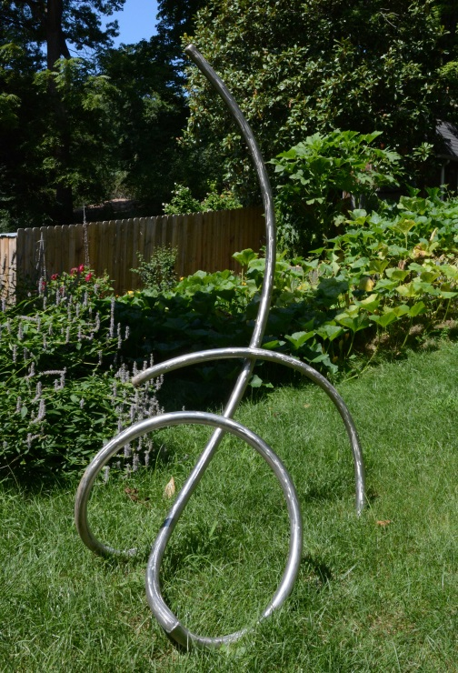
Taking Photos
Can the artists provide photos?
If not, who will take the photos of the artwork? When?
Can you set up a space that is free of background distractions to take the photos?
Should some photos be taken outdoors?

Slide 6
Analyzing and Interpreting Art
What information will you need about each artist or each artwork?
How will you show that the artist and artwork represent the theme of the exhibit?
How will you share that information?

Slide 7
Media and Dimensions
How will you let viewers know the size of the artwork?
How will you let them know the dimensions?

Slide 8
Technical Decisions: Web site
Is there a Web site you can use?
Who will upload and manage the materials?
What can be included?
Do you have signed permissions to use the photos you want to include?
How will your exhibit be accessed from the home page?

Slide 9
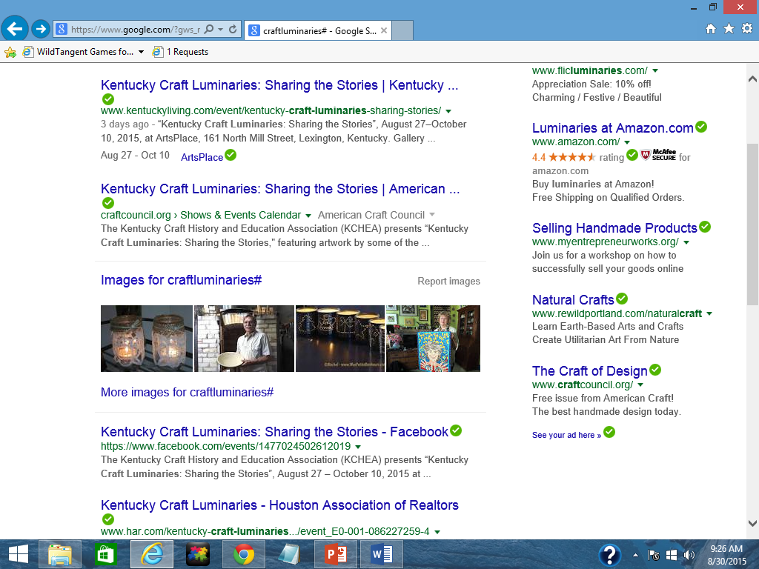
Publicity: Social Media and the Internet
How will you get the word out about your virtual exhibit?
Will you use social media like Facebook, Pinterest, Twitter, Instagram, or YouTube?
Will you create a hashtag#?
What keywords or phrases do you need to use to make your virtual exhibit easy to find?

Slide 10
Assessing the Virtual Exhibit
What will be your criteria for success?
How will you know who visited your website?
Will you use analytical software?
How will you know what people think of your exhibit?
Can you ask for comments on social media?
Will you ask the artists what they thought of the exhibit?
Will you ask artists if the exhibit resulted in any sales for them?

