Slide 1
Visual Imagery in the Kentucky Craft Luminaries Exhibit
Exhibit sponsored by the Kentucky craft history & education association
Photos by jeffrogers.com

Slide 2
Visual Imagery That Conveys Messages
Sometimes artists use visual imagery to convey messages.
This quilted wall hanging is called “Class of 2002” It is from a series by Rebekka Seigel called “The Real Cost of War.”
What images do you see?
What message do the images convey?

Slide 3
The Real Cost of War: THE CLASS OF 2002
33” X 41 1/2 “ 2006 Here is what the artist says about this quilt:
The ﬁnal piece in this series is based on the image of the American ﬂag. The portraits in this piece were scanned into a computer directly from my son’s yearbook and printed onto silk. The photos are surrounded by the disturbing image of the boots, gun and helmet of fallen soldiers used in battleﬁeld memorials. The cost of war for other soldiers is memorialized with the addition of milagros of arms, legs, eyes and mental capacity sacriﬁced in the line of duty.

Slide 4
Images Influence Ideas and Emotions
Did reading what the artist had to say change the way this quilt influenced your ideas or emotions?
Will everyone have the same response to this quilt?
What life experiences might change the way that people respond to this quilt?
Do you think the imagery is effective in conveying a message?

Slide 5
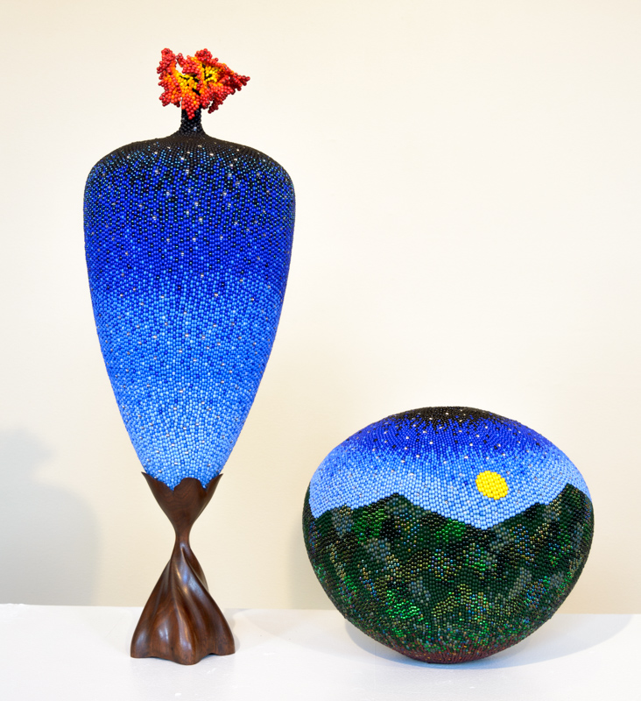
Hills of Home: Beaded Vessels by Linda Fifield
What images do you see in this artwork? What message do you think they convey?
Fifield says, “Being captive to the beauty and miracle of nature, it seems fitting that the work I create reflects my love and respect for the Earth.”
She calls the smaller piece Hills of Home. Does that tell you something about where she lives? Does it suggest a cultural association?

Slide 6
Imagery and Cultural Associations
Minnie Adkins is a well-known folk artist from the rural community of Isonville in Elliott County. She has helped many other folk artists in her community get started in their art careers.
What imagery do you see in her carved table?
She calls this table “Circle of Friends.” What cultural association does the table suggest?

Slide 7
LaVon Williams, Carver Lexington, Kentucky
LaVon Williams uses his relief carvings to share the history of African Americans in the South.
What images do you see in his work?
What do the images express about his culture?

Slide 8
White Oak Egg Basket by Leona Waddell
Traditions are very important to Leona Waddell. Although she adds her own special touches, her baskets are made following the tradition of Hart County basket makers.
Her work has cultural associations. It also conveys a message about traditions. What do you think that message is?

Slide 9
Arturo Alonzo Sandoval, Weaver Lexington, Kentucky
Arturo Sandoval is also concerned about traditions. He uses non-traditional materials in his weaving, but he says “I don’t give up process or tradition, I incorporate it. And…in incorporating it, it becomes my own type of visual language.”

Slide 10
Pattern Fusion No. 1, 2004
In this weaving Sandoval has used recycled materials like recycled auto industry Mylar.
In the Kentucky Crafts Luminary exhibit, you will see the work of artists like Leona Waddell, who follow traditions, and the work of artists like Arturo Sandoval, who incorporate traditions into their own visual imagery.
Kentucky has a rich and diverse artistic culture.

