Slide 1
Craft Luminaries of Kentucky
Sponsored by the Kentucky Craft History & Education Association

Slide 2

What do curators do?
Museums and other institutions have curators. Curators select artworks, artifacts, and other objects for preservation and presentation.
There are also temporary curators who work on special exhibits in a museum, gallery, or other venue.
Curators decide how to exhibit artwork so that people can see it easily and it is protected. They decide how to interpret it so that the exhibit communicates meaning.
Sometimes one curator does all the jobs. Sometimes there are several curators doing different jobs.
Curators must make decisions about each exhibit.
What are some of those decisions?

Slide 3

Setting up an Exhibit: Theme
What will all the artworks in your exhibit have in common?
What story do you want your exhibit to tell?
What do you want your audience to discover?
What do you want them to think about?

Slide 4
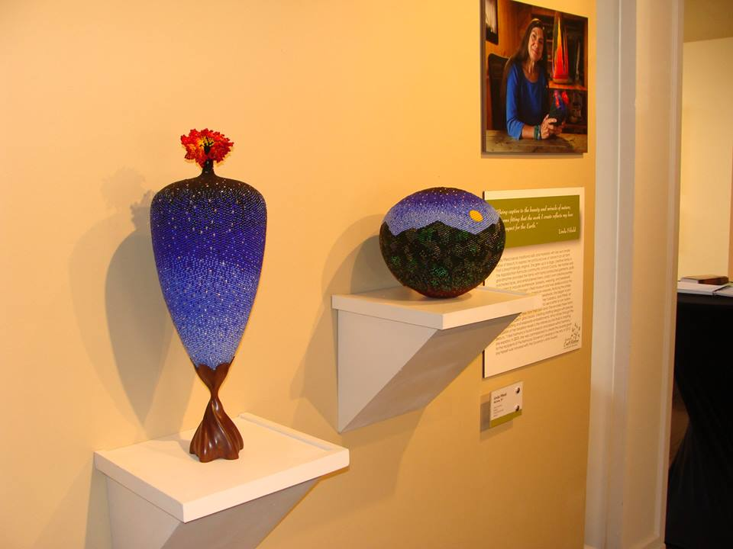
Selecting Artists and Artworks
What is the criteria for selection of the artists or artworks?
Are you going to contact artists and invite them to participate or are you going to have a jurying process?

Slide 5
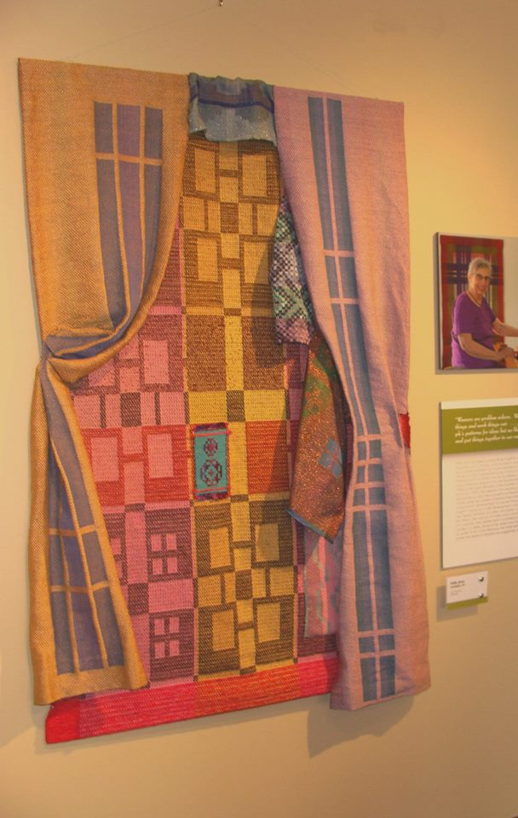
Analyzing and Interpreting Art
What information will you need about each artist or each artwork?
How will you show that the artist and artwork represent the theme of the exhibit?
How will you share that information?

Slide 6
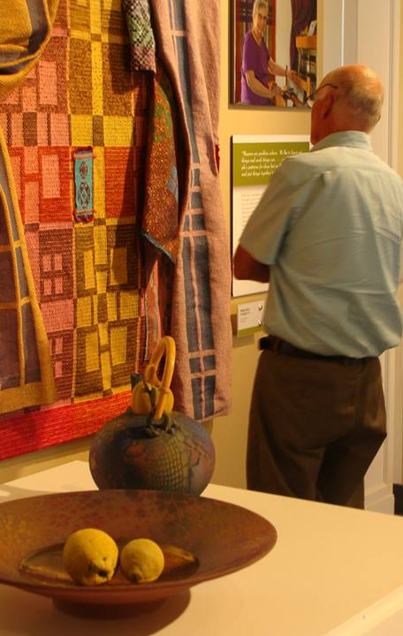
Practical Decisions: Space
How large is your space?
How large are the artworks you want to display?
Which pieces will hang on the wall? How will they be attached?
Which pieces need to be on pedestals? Which need to be on shelves attached to the wall?

Slide 7

Size and Shape
Do you have enough space for large artworks?
Do you have space for free-standing artworks?
How will you be sure that there is enough room for people to walk around the exhibit?

Slide 8
Planning
Measure your space.
Make a floor plan.
Indicate doors and windows.
Plan how to use the wall and floor space.

Slide 9
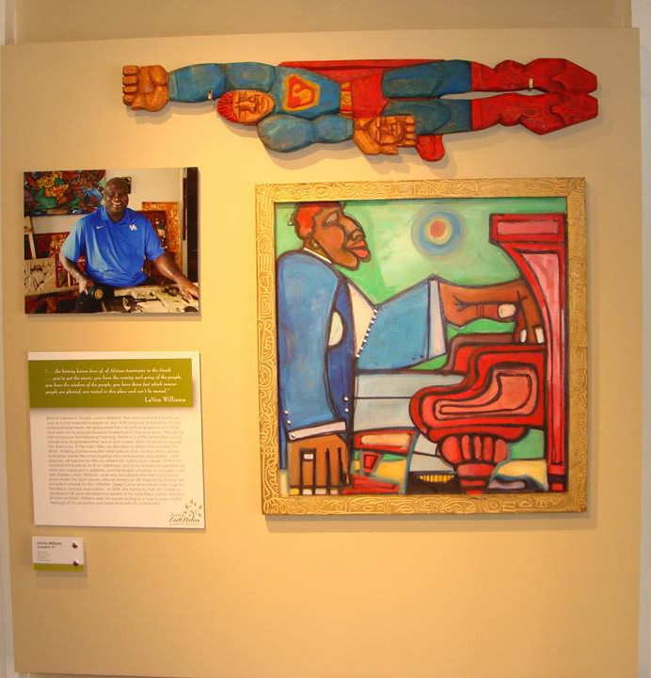
Artistic Decisions: Arrangement
Will you group the work of each artist together ?
Will you group artworks in specific media together?
Will you group artworks that have a common theme together?

Slide 10
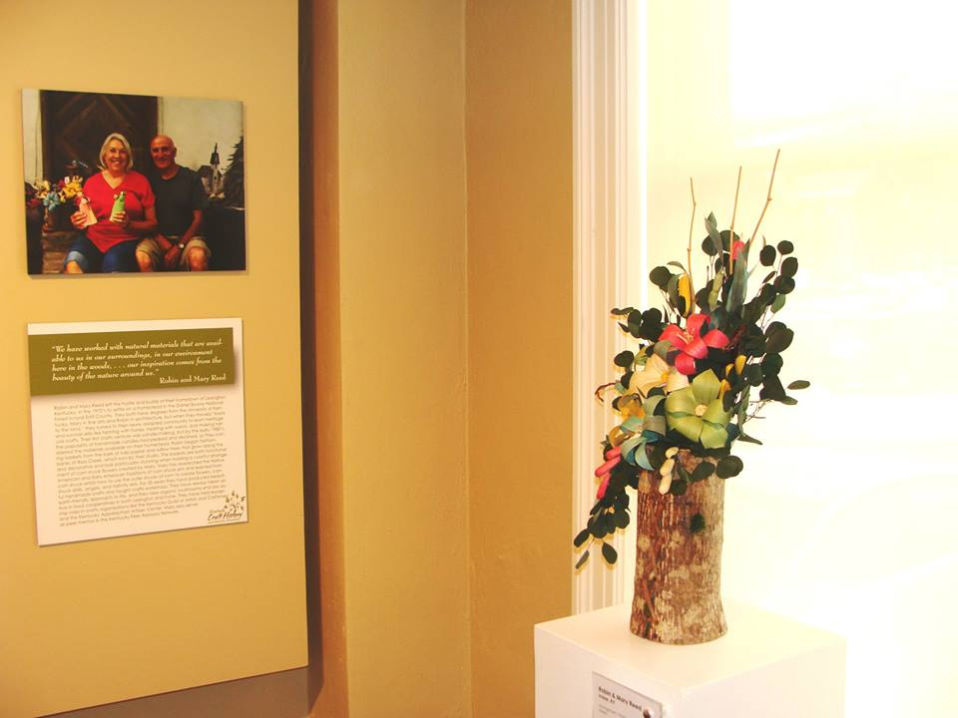
Artistic Decisions: Making Use of the Space
Can you make use of the space in the corners?
What can you do to highlight smaller artworks?

Slide 11
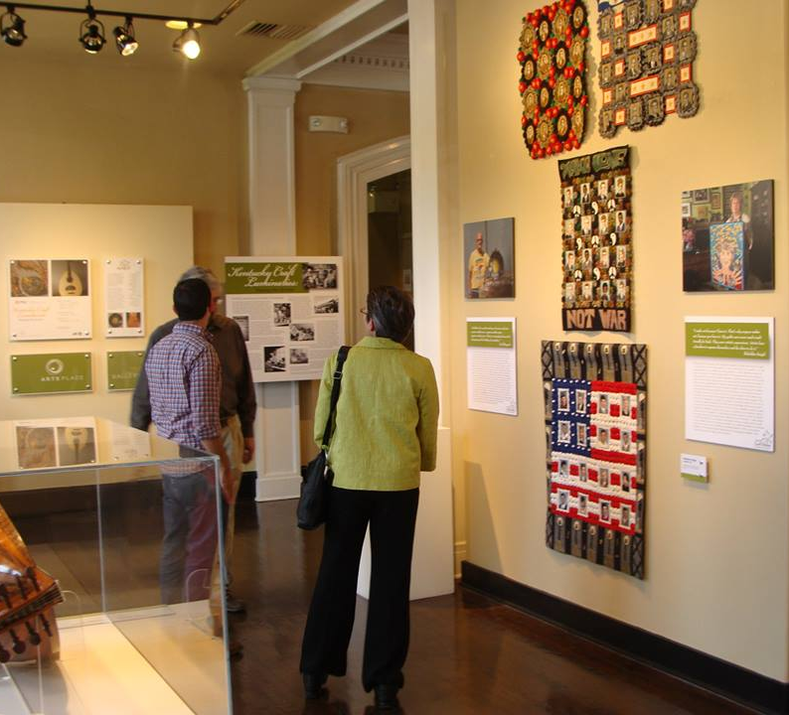
Practical Decisions: Lighting
What lighting is available?
Will people be viewing the artwork in the daytime or in the evening or both?
How will you use your lighting?

Slide 12
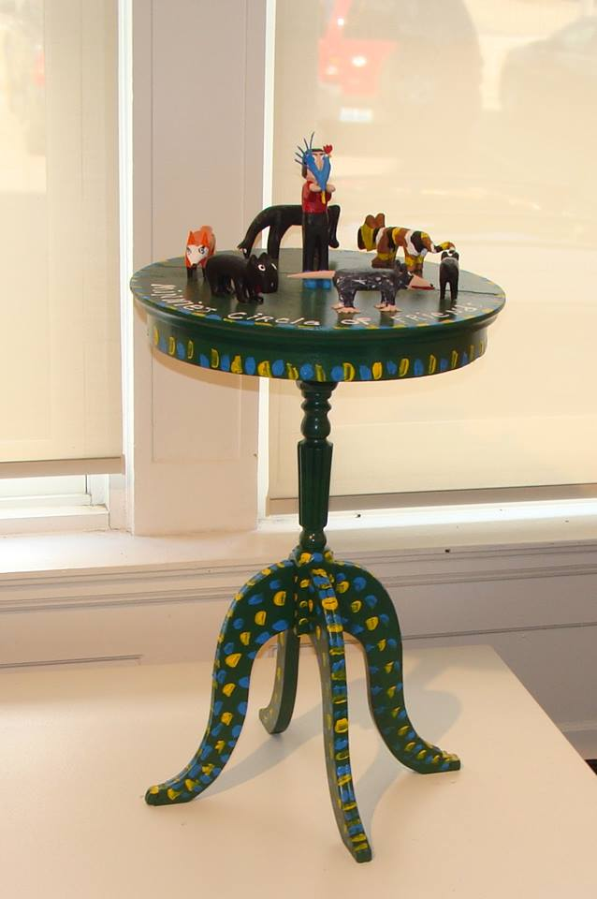
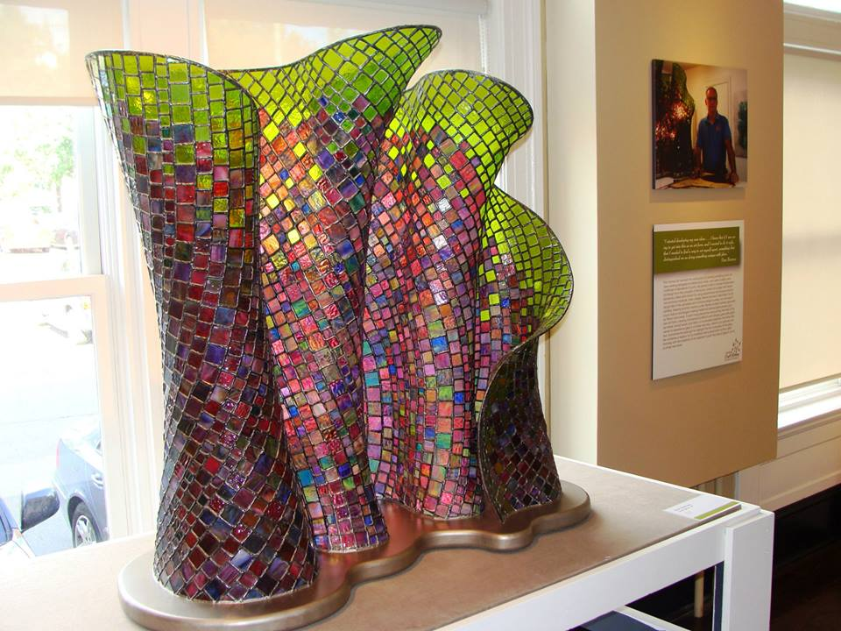
Natural Light: Can you adjust the window shades? Which artworks need to have light behind them? Which artworks need to have the shades drawn?

Slide 13
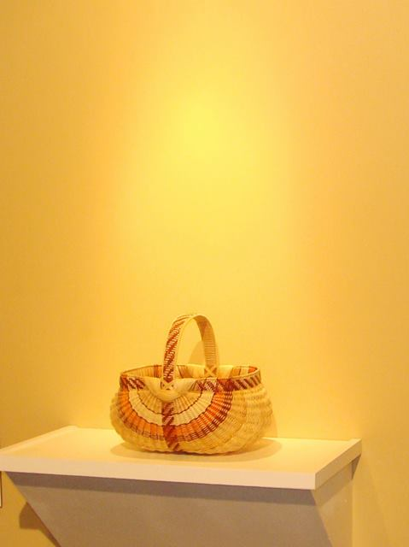
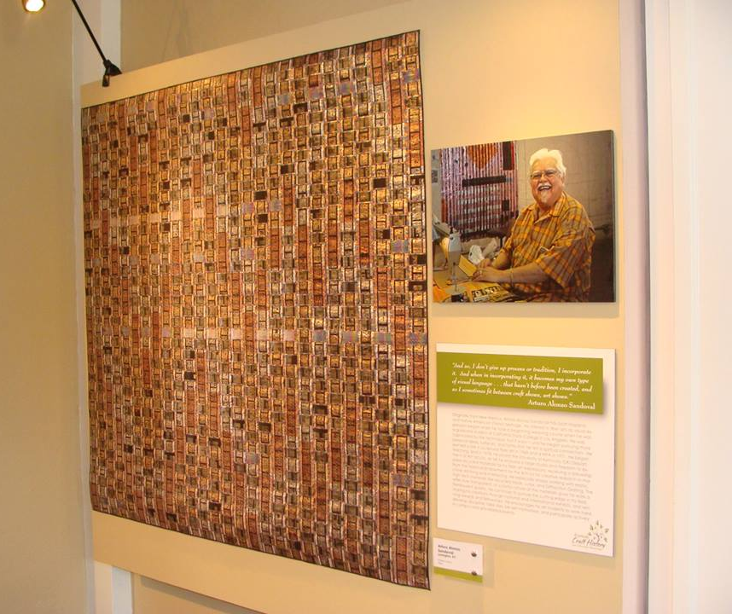
Artificial Light: Do you have smaller lights or track lights that you can use? Which artworks should be highlighted? Should the light come from straight above or at an angle?

Slide 14
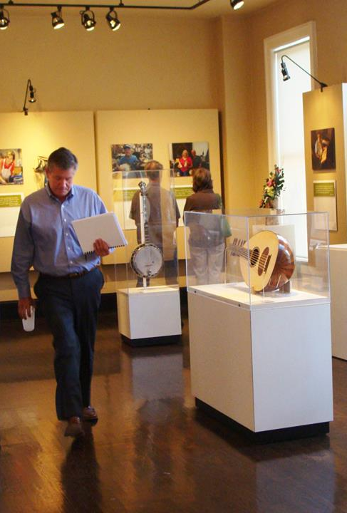
Practical Decisions: Protection
Which artworks in the exhibit need special protection?
Do you have display cases you can use? Can you build some?
Is there enough space around the display cases so that people will not bump against them?

Slide 15
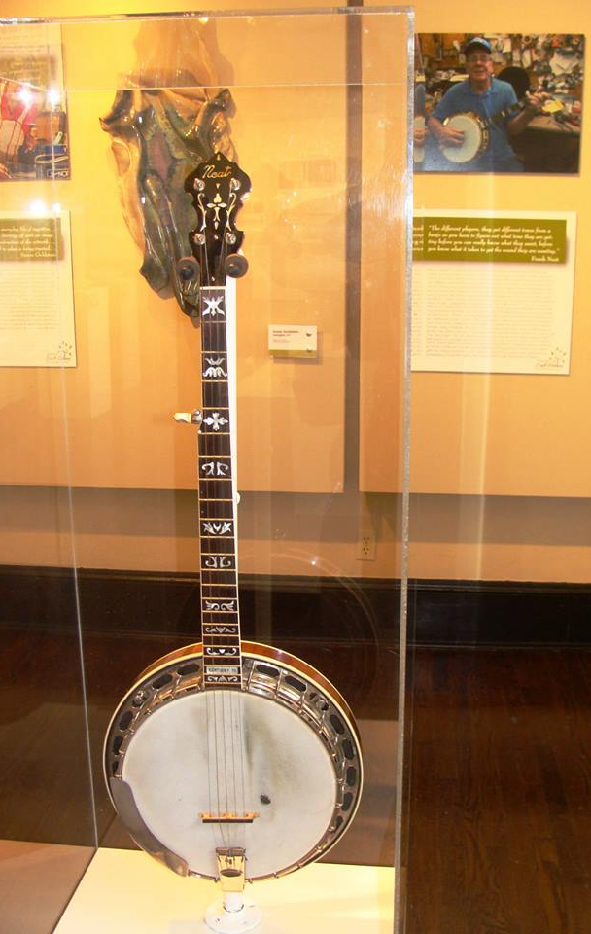
Display Cases
What size and shape do the display cases need to be?
How will you mount the artworks inside the display cases?

Slide 16
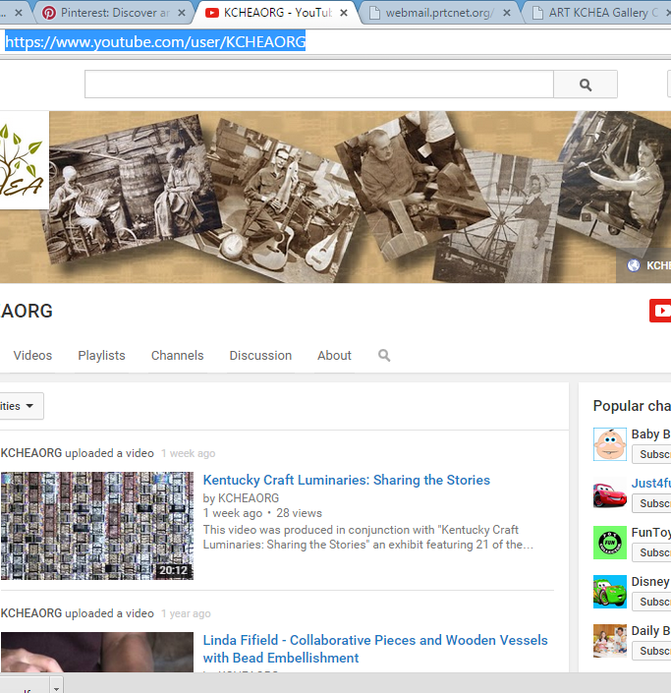
Multimedia Components
Will your exhibit have a multimedia component?
How will the multimedia component be presented at the exhibit?
How else will it be accessible?
How will you publicize it?

Slide 17

Publicity: Special Events
Will you have a special event such as an opening reception?
Will you send out invitations?
What information will you include?
Who will receive invitations?
What sponsors do you need to thank?

Slide 18
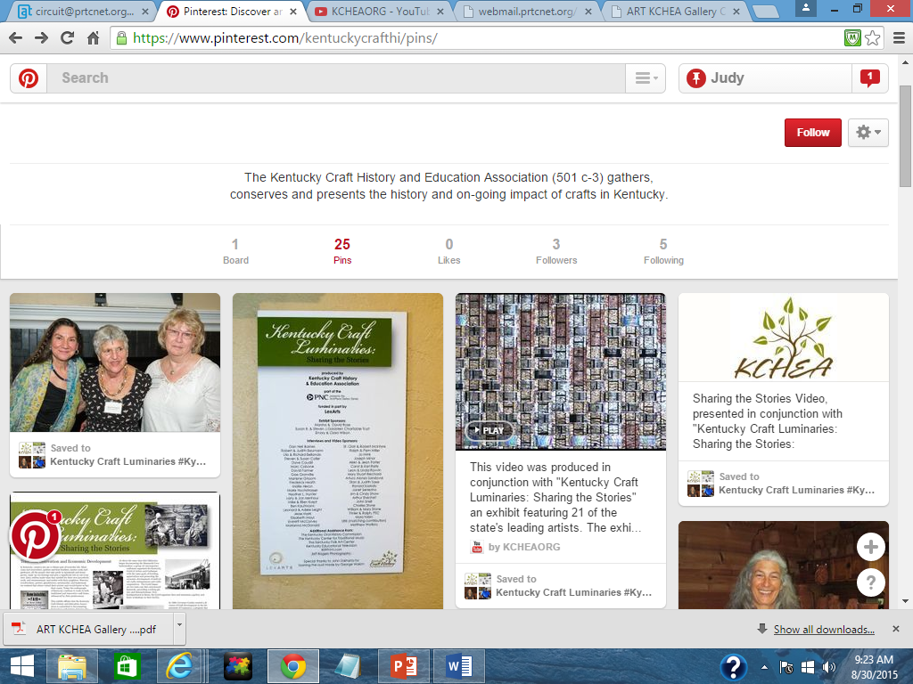

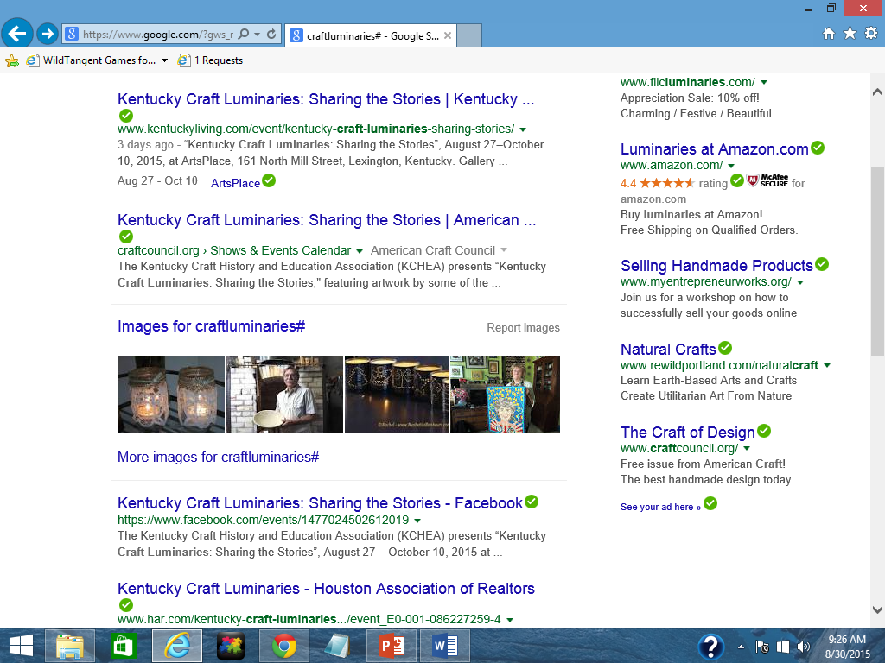
Publicity: Social Media and the Internet
Will you post information on a Website?
Will you use social media like Facebook, Pinterest, Twitter, Instagram, or YouTube?
Will you create a hashtag#?

Slide 19

Publicity: Newspapers
Will you place ads or stories in newspapers?
Who will write the stories?
Which newspapers should you include?
Will you need to change the story depending on the newspaper?

Slide 20
Assessing the Exhibit
What will be your criteria for success?
Will you have artwork for sale? How will you track sales?
How will you know who came to the exhibit?
Will you have a guest book for people to sign?
How will you know what people think of your exhibit?
Will there be space in the guest book for people to make comments?
Will you ask the artists what they thought of the exhibit?

